Slide 1

Course: BSc CSIT
Madan Bhandari Memorial College
Geographic Information System
History of GIS and Geospatial Technology
CSC482 Unit-1 Class 3
Dfw' ;'bg clwsf/L

Slide 2
Agenda
Beginnings of Spatial Analysis
Birth of Modern GIS
The First GIS
Developments in Geospatial Technology (1960s–70s)
Commercial GIS Software and Personal Computers (1980s)
GIS Goes Mainstream (1990s)
The Age of Web GIS and Global Applications (2000s)
Mobility, Big Data, and Real-Time GIS (2010s-Present)
History of GIS in Nepal

Slide 3
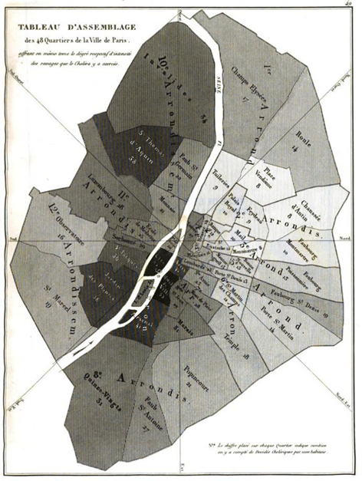
Beginnings of Spatial Analysis
Charles Picquet's 1832 Cholera Map
Used halftone gradients to show cholera intensity across 48 Paris districts.
First recorded use of spatial analysis in epidemiology
Published in the report Rapport sur la marche et les effets du choléra-morbus dans Paris
(Report on the spread and effects of cholera morbus in Paris)

Slide 4
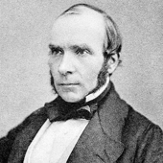
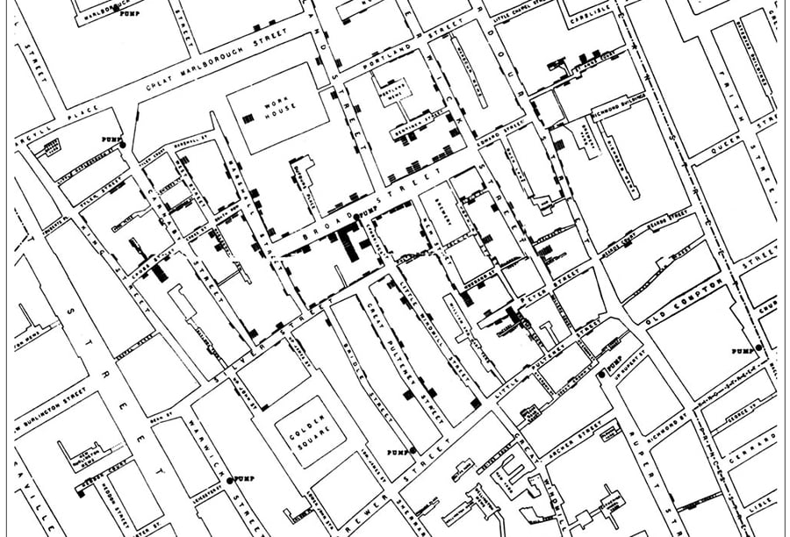
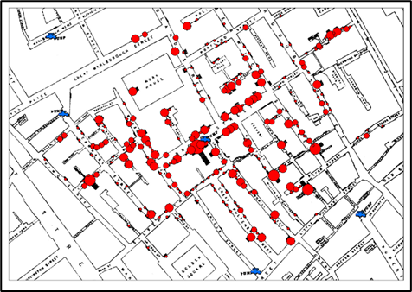
Beginnings of Spatial Analysis…
Dr. John Snow's 1854 Cholera Map
Mapped cholera deaths in London around a contaminated water pump.
Introduced layered spatial thinking using paper maps.
Dr. John Snow’s 1854 cholera map of London, showing cholera deaths (black bars) clustered around a contaminated water pump (red dot). By mapping the locations of deaths and water sources, Snow was able to pinpoint the Broad Street pump as the source of the outbreak.

Slide 5
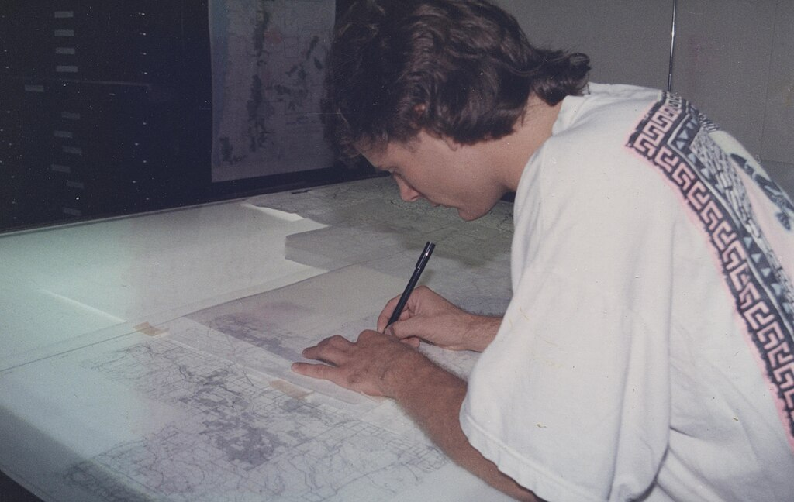
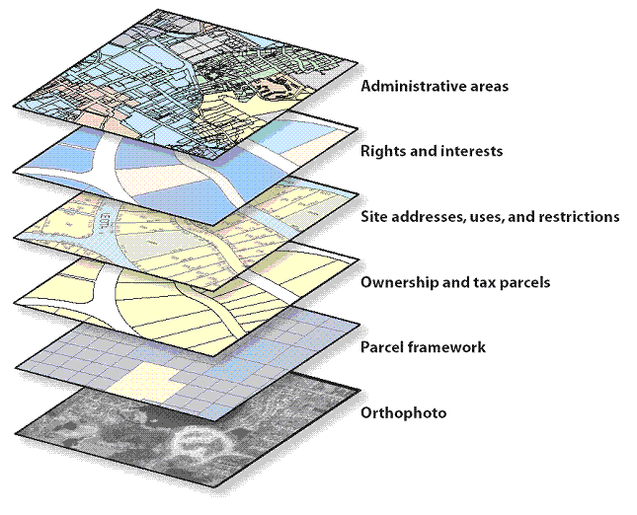
Birth of Modern GIS
Before 1960: The GIS Dark Ages because nothing had been developed in Computer mapping
All mapping was done on paper or sieve mapping.
Sieve mapping uses transparent layers on light tables to identify areas of overlap.

Slide 6
Birth of Modern GIS …
Paper maps posed major challenges:
  calculating areas was nearly impossible,
  data was often coarse and inaccurate,
  measuring distances was tedious.
These limitations drove to seek digital alternatives
cartographers and spatial analysts shifted to computer-based mapping
a pivotal step in the evolution of GIS.

Slide 7
The First GIS
By the 1960s the first computer-based GIS was launched in Ottawa, Canada
Canadian geographer Dr. Roger Tomlinson, developed the first version of a computerized GIS in 1963
Canada Geographic Information System (CGIS)
Developed for land inventory.
Overlay concept introduced digitally.
First true GIS platform.
Roger Tomlinson – the father of GIS

Slide 8
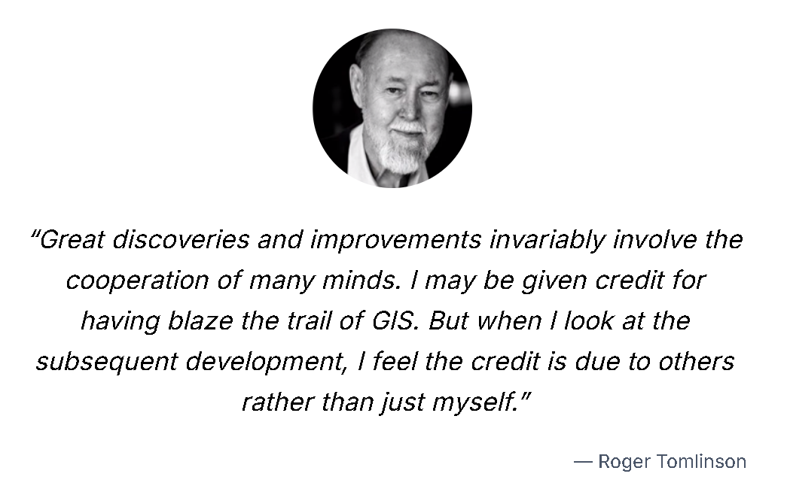
Father of GIS

Slide 9
Developments in Geospatial Technology (1960s–70s)
4 October 1957, launch of Sputnik-1 by USSR was the beginning of space age, the early seed of RS
Television and Infrared Observation Satellite (TIROS), was launched on 1 April 1960 by the United States
The late 60s and early 70s saw parallel advances that fed into GIS.
The first multi-spectral photography from space took place during the 1968 Apollo-9 mission

Slide 10
Developments in Geospatial Technology (1960s–70s)
Relational database model proposed by Edgar Codd (1970) enabled structured attribute data storage
Early Database Management Systems (DBMS) supported efficient GIS data management
Launch of Landsat 1 (1972) marked the beginning of satellite-based remote sensing
With the launch of Seasat on 26 June 1978 by the NASA, the world entered an era of satellite-borne radar remote sensing.
Seasat was the first civil synthetic aperture radar (SAR) satellite

Slide 11
Developments in Geospatial Technology (1960s–70s)
U.S. military-initiated development of the Global Positioning System (GPS)
GIS, remote sensing, and GPS together formed the basis of modern geospatial technology
U.S. Census Bureau developed Dual Independent Map Encoding (DIME) system to digitize census maps
USDA began applying GIS for soil mapping and land resource analysis

Slide 12
Commercial GIS Software and Personal Computers (Late 1970s–1980s)
Early Advancements in GIS Software
  Governments saw the potential of digital mapping, influencing Harvard Laboratory for Computer Graphics.
  Mid-1970s: Harvard developed ODYSSEY GIS, the first vector-based GIS.
  Esri’s ARC/INFO built upon ODYSSEY’s framework, leading to GIS software commercialization.
Rise of GIS Software Products (Late 1970s–1980s)
  Hardware improvements (memory & graphics) enabled new GIS tools:
    Examples: GIMMS, MAPICS, SURFACE, GRID, IMGRID, GEOMAP.
  Late 1980s: Growing variety of GIS vendors entered the market.
Esri's Key Role in GIS History
  1982: Esri launched ARC/INFO for minicomputers.
  1986: Released PC ARC/INFO for Intel microcomputers.Today, Esri is the world’s largest and most influential GIS software company.

Slide 13
Community, Conferences, and Terms
First UK GIS meeting: 1975 – small academic gathering.
First Esri User Conference: 1981 – only 18 attendees.
GIS consultancies and communities began forming.
Michel Paradis introduced the term “Geomatics” in the 1980s to unify spatial disciplines.
In the 1980s, the term “Geographic Information Science” (GIScience) was introduced (by Michael Goodchild and others)
Tomlinson is also widely credited with coining the term Geographic Information System
His article, A Geographic Information System for Regional Planning, published in 1968, is the “The first known published use of the term Geographic Information System in August 1968.”

Slide 14
GIS Goes Mainstream (1990s)
GIS adopted widely across government, academia, and industry.
Graphical User Interfaces (GUIs) made GIS more user-friendly.
  Example: ArcView GIS launched in 1993 with iconic GUI.
Explosion of digital spatial data:
  USGS released digital elevation models (DEMs).
  Governments provided digital census and TIGER files for streets.
GIS began to be taught as a distinct university subject.

Slide 15
GIS Goes Mainstream (1990s)
Internet era began shaping GIS:
  Early web mapping tools like MapQuest (1996) emerged.
Integration with GPS and remote sensing increased:
  Field data and satellite images could be imported and analyzed.
GIS became critical in sectors like:
  Urban planning, environmental management,
  Defense,
  public health, and more.

Slide 16
The Age of Web GIS and Global Applications (2000s)
🌐 Public Web Mapping Tools
  2005: Launch of Google Maps and Google Earth revolutionized public access to GIS.
  Introduced APIs, Street View, mobile integration, and real-time navigation.
  Microsoft Bing Maps (Virtual Earth) and Yahoo Maps entered the scene.
  OpenStreetMap (2004): Crowdsourced global map project grew rapidly by 2007–08.
📶 Internet Infrastructure & Web Standards
  Web 2.0 and AJAX enabled fast, interactive online maps.
  Rise of cloud computing (e.g., AWS 2006) supported large-scale GIS hosting.
  OGC standards (WMS, WFS) allowed GIS systems to share maps/data over the web.
  Map tiling and JavaScript APIs became the new norm for GIS delivery.

Slide 17
The Age of Web GIS and Global Applications (2000s)
🗂️ Spatial Data Infrastructure & Open Data
  Dozens of countries built national SDIs and geoportals (e.g., US, India, EU).
  The INSPIRE Directive (2007) unified spatial data in the EU.
  Data.gov (2009) in the US led global open government data trends.
  NGOs, NASA, and citizen groups released large volumes of open spatial datasets.
🧰 Evolution of Professional GIS Platforms
  Esri ArcGIS 8 & 9 integrated desktop, server, and web GIS.
  ArcIMS, ArcGIS Server, and APIs enabled enterprise and online mapping.
  QGIS (2002–2009): Open-source alternative matured with v1.0 in 2009.
  Other tools: MapServer, GeoServer, MapGuide OS, and GRASS.

Slide 18
The Age of Web GIS and Global Applications (2000s)
🌐 Geoportals & Clearinghouses
  Governments launched public map portals (e.g., GeoBase Canada, INSPIRE EU).
  Metadata clearinghouses enabled GIS dataset discovery across agencies.
  Regional/global platforms (e.g., UN, World Bank, ESA) expanded access.
🌱 GIS Adoption Across Sectors
  Agriculture: Precision farming with GPS-guided equipment, soil/crop mapping.
  Health: WHO’s Malaria Atlas Project, vaccination targeting, outbreak mapping.
  Disasters: NASA-USAID SERVIR hubs launched for flood/fire monitoring in Asia & Africa.
  Humanitarian GIS: Crisis mapping (e.g., Haiti 2010 via OpenStreetMap) saved lives.
  Logistics: GIS used by FedEx, UPS, governments for route planning, asset tracking.

Slide 19
Mobility, Big Data, and Real-Time GIS (2010s-Present)
Mobile GIS Revolution
  Smartphones and apps brought GIS to the palm of public.
  Field data collection, navigation, ride-sharing, delivery tracking, etc
  Location-based social media and services became mainstream.
Big Data & IoT Integration
  GIS now processes massive, real-time datasets.
  Millions of live location feeds from sensors, vehicles, devices.
  Internet of Things (IoT) generates continuous spatial data streams.

Slide 20
Mobility, Big Data, and Real-Time GIS (2010s-Present)
Cloud-Based GIS Platforms
  Platforms like ArcGIS Online & Google Earth Engine enable:
    Web-based spatial analysis and visualization.
    Global data access and sharing.
    Collaborative mapping.
3D & Time-Aware GIS
  3D GIS allows modeling of buildings, cities, and landscapes.
  Integration with BIM (Building Information Modeling).
  Time-aware GIS helps analyze changes over time (4D GIS).

Slide 21
Mobility, Big Data, and Real-Time GIS (2010s-Present)
Open Source & Open Data Movement
  OpenStreetMap and crowdsourced mapping democratized geospatial data.
  Growth of open-source GIS tools
    QGIS,
    GeoServer,
    PostGIS
Geospatial Technology Ecosystem
  Modern GIS integrates:
    Mapping & spatial analysis software.
    GPS/GNSS positioning systems.
    Remote sensing imagery & drones.
    Spatial databases & real-time web services.
  GIS now serves as a core technology for solving global challenges.

Slide 22
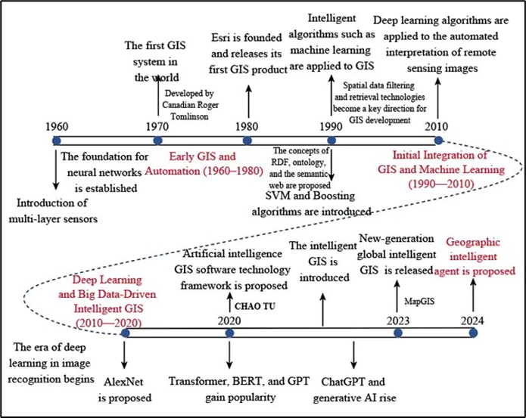
https://www.eurekalert.org/multimedia/1062933#:~:text=Caption.%20The%20development%20of%20GIS%20and%20artificial,learning%20and%20big%20data%2Ddriven%20intelligent%20GIS%20(2010%E2%80%932020).

Slide 23
History of GIS in Nepal
🛰️ Early Beginnings (Late 1980s – Early 1990s)
  Nepal began adopting GIS via internationally assisted mapping projects.
  Survey Department (est. 1957) transitioned from analog to digital cartography.
    Key partners: Finnmap (Finland) and JICA (Japan).
  Early software introduced: ARC/INFO, IDRISI, ERDAS.
  Focused on: land-use mapping, watershed management, resource inventories.
  Use of Landsat imagery and aerial photos spurred a generation of GIS-trained professionals.

Slide 24
History of GIS in Nepal
🏛️ Institutionalization (Mid–Late 1990s)
  Establishment of major national GIS units:
    National Remote Sensing Centre NRSC under the Department of Forestry promoted GIS.
    DFRS produced Nepal’s first digital forest cover maps.
    DHM and DoI applied GIS to floods, hydrology, and watershed analysis.
  CBS used GIS in census boundary mapping—early socio-economic spatial analysis.
  Tribhuvan University introduced GIS/RS in curriculum with UNESCO and ICIMOD support.
  Built Nepal’s first generation of GIS professionals.

Slide 25
History of GIS in Nepal
🚀 Expansion & Capacity Building (2000s)
  Rapid spread of GIS across government, municipalities, and development sectors.
  ICIMOD’s MENRIS program delivered data, training, and national support.
  Launch of NGIIP project (with Finnish & Japanese aid):
  Focused on data standards, metadata, and institutional coordination.
  Municipalities adopted GIS for urban planning, zoning, and infrastructure mapping.
  Enabled by the Local Self-Governance Act (1999) emphasizing evidence-based planning.

Slide 26
History of GIS in Nepal
🔗 Modern Phase (2010s–Present)
GIS became central to national governance and planning.
Institutions like NPC, Survey Dept., DoLMA integrated GIS into:
  Land administration, cadastral digitization, spatial monitoring.
2015 Gorkha earthquake: GIS used for “crisis mapping” and real-time aid coordination.
  Combined OpenStreetMap, field data, and satellite imagery.
GIS now supports:
  Disaster management (landslides, floods)
  Urban development (e.g. Kathmandu)
  Cultural heritage preservation

Slide 27
History of GIS in Nepal
📊 National GIS Initiatives Today
  Digital Nepal Framework and DNLAS for land system digitization.
  Land Use Plans and Zoning Maps for smart spatial planning.
  DRRM systems integrating live hazard data.
  Environmental monitoring and climate adaptation with satellite/GIS analytics.
🎓 GIS Education & Research in Nepal
GIS is embedded in:
Government training centers (Land Management Training Center, Survey Dept., CTEVT)
Universities (Tribhuvan, Kathmandu, Pokhara)
Regional hubs like ICIMOD continue building national GIS capacity.

Slide 28
Thank You

